Slide 1

All you need to know…

Slide 2

Acknowledgement of Country
We acknowledge the Traditional Custodians of the land we are meeting on for their continuing connection to land, sea, community and culture. We pay our respects to their Elders past and present.
Notes:
Before we begin, I would like to start with Acknowledgement of Country and take the opportunity to show the respect we have for the country, the people and water we are on.
We recognise Aboriginal and Torres Strait Islander peoples as Traditional Owners of the land and pay our respects to their Elders past and present.

Slide 3



What is the Medical Training Survey?
The Medical Training Survey gathers feedback from doctors in training across Australia to:
Understand
Better understand the quality of medical training in Australia
Identify and improve
Identify how best to improve medical training in Australia
Recognise and respond
Recognise and deal with potential issues in medical training that could impact on doctor in training and patient safety, including environment and culture, unacceptable behaviours and poor supervision.
Notes:
The Medical Training Survey aims to understand the experience of Doctors in Training to affect change.
The objectives are:
better understand the quality of medical training in Australia
identify how best to improve medical training in Australia, and
recognise and deal with potential issues in medical training that could impact on patient safety, including environment and culture, unacceptable behaviours and poor supervision.
The Medical Training Survey has been running since 2019.

Slide 4
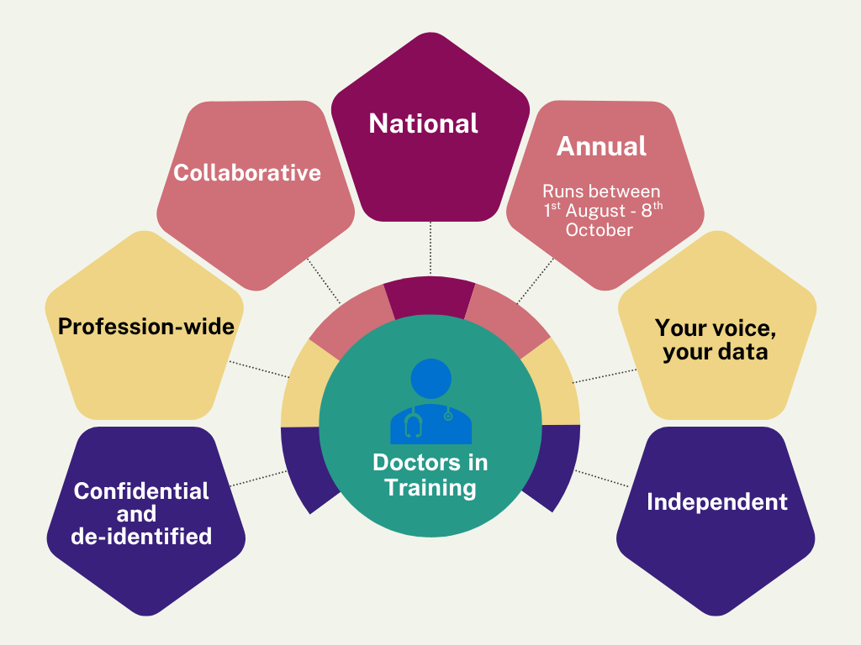
The Medical Training Survey is:
Notes:
The MTS is:
Anonymous: There is no link between you and your survey feedback. all results are hosted by an independent 3rd party, with only de-identified data provided to Ahpra and the Medical Board of Australia.
Profession-wide: The survey is provided to all doctors in training, across all specialties and years of practice. This includes interns, hospital medical officers, resident medical officers, non-accredited trainees, postgraduate trainees, principal house officers, registrars, specialist GP trainees and specialist non-GP trainees. Career medical officers who intend to undertake further postgraduate training in medicine can also participate.
Collaborative: A joint project from doctors in training, employers, educators, professional associations and regulators. Is supported by doctors in training, specialist colleges, employers, health departments, educators, the AMA, Doctors’ Health Services, Postgraduate Medical Councils, Australian Indigenous Doctors’ Association, the Australian Medical Council, the Medical Council of NSW, the Medical Board of Australia and Ahpra.
National: it is the only national survey across Australia
Annual: it runs every year at the time of registration renewal (Aug-and early October)
For doctors in training: Use your voice, do the Medical Training Survey. Use your data: MTS data is public and can inform your choice of training site and specialty
Independent: a 3rd party hosts and runs the survey – EY Sweeney

Slide 5
What’s in the MTS ?
Demographic
Training program
Training post
Events
curriculum, assessment, engagement with trainees
workplace environment and culture, access to teaching, clinical supervision and wellbeing
Patient safety
Overall satisfaction
About you
Future career intentions
Notes:
Routine survey questions fall into six broad topics and ask for doctor in training feedback on the following issues:
Demographic
Training program curriculum
Training program assessment
College engagement with trainees
Workplace environment and culture
Access to teaching
Clinical supervision
Training post orientation
Wellbeing
Patient safety
Overall satisfaction
Future career intentions
About you
Survey questions are tailored to the needs of each group of doctors in training.

Slide 6




Why it’s so important
Quality improvement
Feedback
Reflective practice
Your voice, your data
Notes:
Your feedback helps!
It is safe and confidential to do the MTS. Survey data is de-identified in reporting of results. Only de-identified data is shared with the Board and Ahpra.
The MTS encourages trainees to reflect on their medical training and teaching and provide feedback to support continuous improvement.
Reflective practice is a cornerstone of good medical practice and of the Professional Performance Framework.
MTS data is a valuable quality improvement tool for stakeholders who are developing and delivering medical training.
Visit MedicalTrainingSurvey.gov.au to read how stakeholders are using the results to drive positive change in medical training in Australia.

Slide 7

MTS questions reflect training
There are five versions of the Medical Training Survey.
Each version is tailored to a different group of doctors,
at different stages of training.
Most survey questions are common across the surveys.
Notes:
There are 5 versions of the MTS, one each for.
Interns
Prevocational and unaccredited trainees
Specialist trainees (non-GP)
Specialist GP trainees
IMGs
Most questions are common across all surveys, the rest are tailored to each group of doctors in training:
There are different versions of the survey to reflect the particular training environment of doctors at different stages in their training. For example, questions that we ask interns and accredited trainees, reflect their unique training environments
The MTS builds on doctor in training surveys conducted by jurisdictions and colleges
The MTS generates national, cross profession data being used to improve medical training.
Doctors in training helped design the Medical Training Survey from the beginning. There are doctor in training representatives that sit on the governance structure.
Other doctors in training have helped by testing the survey questions. We wanted to make sure the questions were easy to understand, written clearly and that survey answers would properly capture the experience of medical training in Australia. Doctors in training were great at telling us what we had missed, what worked well and what we needed to improve.

Slide 8

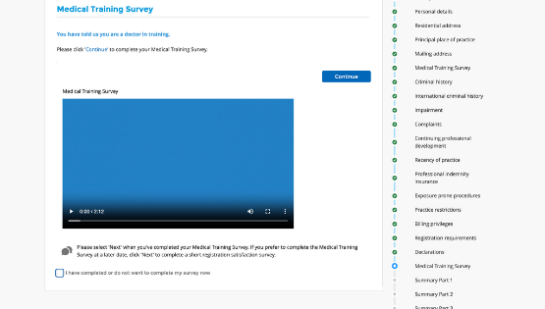


How to do the survey
Prevocational and
unaccredited trainees
Specialist trainees
(non-GP)
Specialist GP trainees
Renewal of registration
Last step
Notes:
Doctors in training do the survey when they renew their medical registration in August – September:
First register
Complete registration renewal
Complete the Medical Training Survey as the last step
When you renew your registration, your survey link will appear at the end of registration process. A pop-up box will appear. Simply click ‘continue’ to start your Medical Training Survey!
If you miss it, Ahpra will send it to you your link in the email confirming your registration renewal.

Slide 9

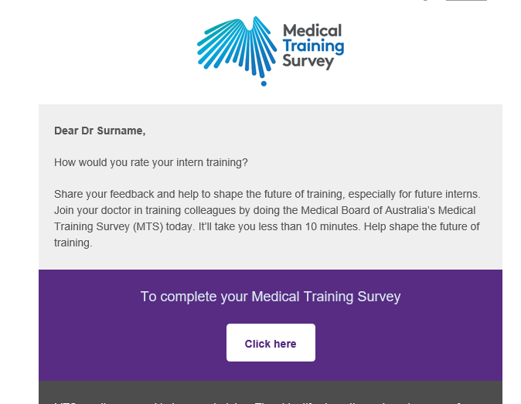

How to do the survey
Interns
IMGs
Email from the Medical Board of Australia with a unique survey link
Notes:
For Interns and IMGs, you will receive an email invitation from the Medical Board of Australia to participate in the MTS. This email will contain a unique survey link

Slide 10
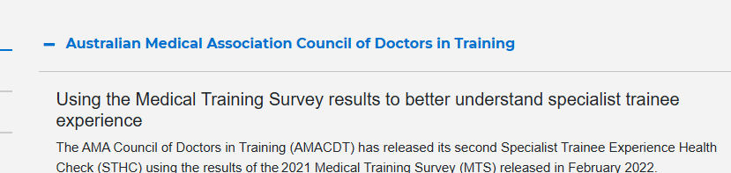
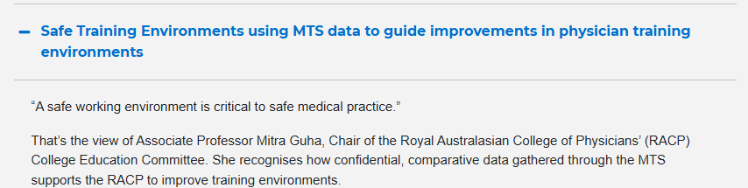
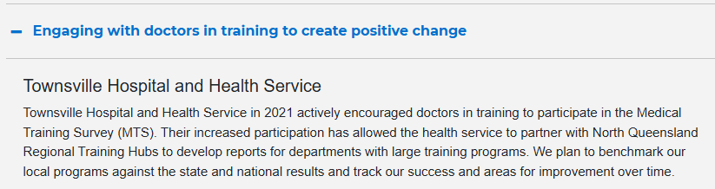
Impact: Results are being used now
Notes:
Stakeholders are using the results more and more to identify areas for improvement and drive positive change in the medical training space.​
​
Some examples include:​
Advocacy: The Australian Medical Association using the results to provide a comparison of the training experience between different specialty training pathways and identifies areas of excellent experience as well as areas for improvement.​
Accreditation: Australian Medical Council are using it for accreditation assessments and monitoring activities.​
Health and wellbeing: QLD Health are using the data to support their work on mental health and wellbeing for QLD doctors.​
Workforce strategy: Council of Presidents of Medical Collects is using the data to shape workforce policy​
Workplace culture: Royal Australasian College of Physicians stated that the MTS data was used to drive the Safe Training Environments Summit. Education and trainee leaders and invited guests agreed on a strategic approach to tackling bullying, harassment, and discrimination in physician training environments.

Slide 11
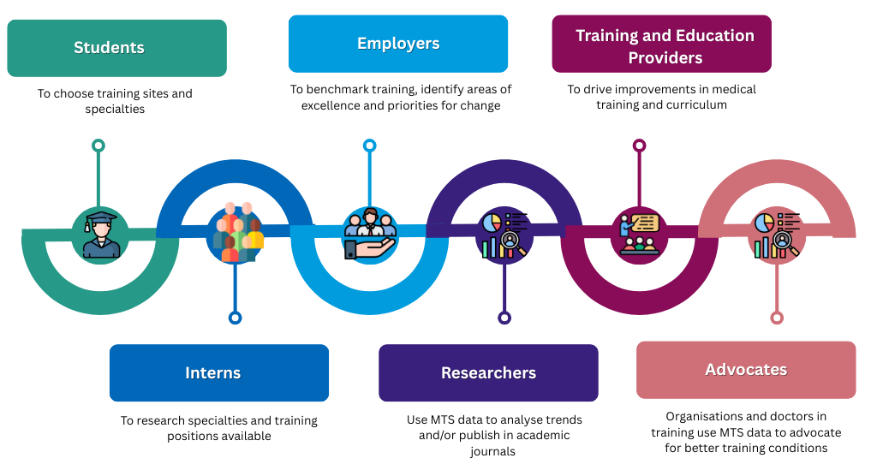
Impact: how the results are used
Notes:
Different cohorts are using the MTS data in different ways
Students and doctors in training are utilising the results to understand and identify their preferred training positions and specialties
Employers are using the results to identify points of excellence and areas for improvement in order to attract and retain the best people and staff
Researchers can extract the data and use it as a data sources for publications, case studies, longitudinal studies, PhD’s etc.
Training providers can use the data to drive improvements in medical training and curriculum
Advocates can extract the data to use in advocacy pieces
The Medical Board, regulators and professional bodies are using the results to identify areas to be highlighted as well as those requiring strengthening. The results help to inform changes to standards, accreditation and training requirements

Slide 12
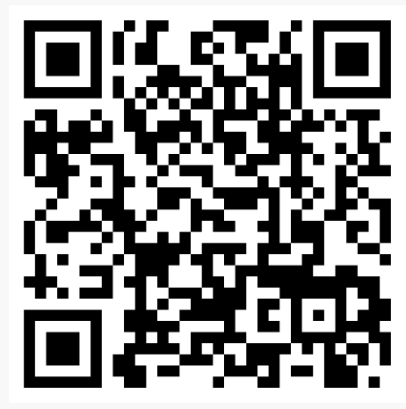
Find out more
MedicalTrainingSurvey.gov.au
Notes:
There is a dedicated MTS website, with loads of information about the survey, including results from 2019 to 2024.
All you need to know about the Survey is published on the website!
This includes:
Results from the 2019, 2020, 2021, 2022, 2023 and 2024 surveys
Interactive dashboard where you can create your own tailored reports – with options to output in Excel or PDF
Watch the video to learn how to use the dashboard
Communications toolkit
Survey questions

Slide 13

Opens August 2025
For more information visit: www.MedicalTrainingSurvey.gov.au

